Slide 1

AI DRIVEN NOTES APPLICATION
Present by
Fasiha Rohail-bsse23041
Abdul Samad Sohail-bsse23083

Slide 2



CONTENTS
1
Problem Statement
6
Screen Shots And Demo Videos
2
Technology Stack
7
PM2 Testing
3
Architecture Diagram
4
Software Architecture Pattern
5
Software Architecture Pattern

Slide 3

The Problem
Modifying document text manually is time-consuming. Users need a way to "AI-rewrite," "Summarize," or "Modify" text directly within the single platform with the button.
Technical Hurdle
Connecting a secure Google API environment to a custom Node.js backend while maintaining a stable, load-balanced connection.
PROBLEM STATEMENT
Solution
An AWS-hosted application using an Application Load Balancer (ALB) to manage traffic and a Node.js backend to bridge user chat with the Groq AI API.

Slide 4




WHY GROQ API ?
High Performance , Zero Cost
Ultra Low Latency
Developer Friendly Integration
Allowed for unlimited testing and iterative development of the Notes App integration without incurring infrastructure costs.
For Notes App text modification, the replacement text appears almost instantly, providing a seamless "real-time" user experience.
Fully compatible with OpenAI-style API structures, making it a drop-in replacement for the backend architecture.

Slide 5
TECHNOLOGY STACK
Front End (Prsentation lLayer)
Backend& Security
Infrastructure & Dev Tools
Intelligence (AI Interface)
HTML 5 & CSS3
Java Script
React
Node.js
Express.js
JWT
JSON Web Token
Bcrypt (password Hashing)
Dynamo DB
CORSE (Gateway For Backend)
EC2
PM2
ALB (Application Load Balncer)
AWS Dynamo DB
Vs Code
Git
Groq API
SDK ( For Our Frontend to talk to Groq API)

Slide 6
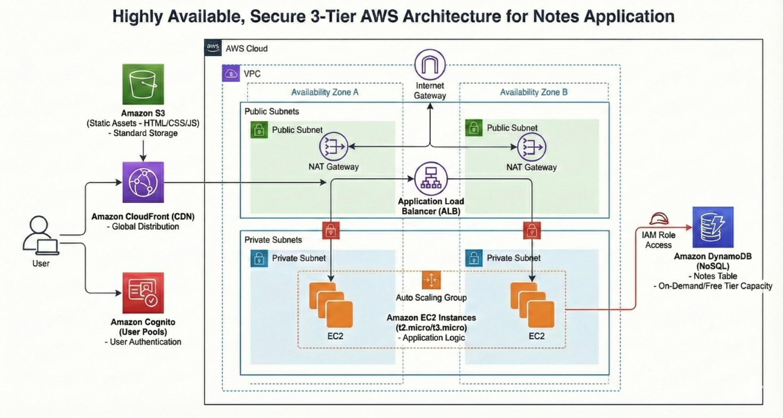
ARCHITECTURE DIAGRAM

Slide 7
Model (Data And Logic)
It manages the "truth" of the application. It doesn't care what the website looks like; it only cares about taking text, sending it to the AI, and getting a valid response back.
The View
This is the only part the user sees. It displays the notes, the chat bubbles, and the login forms. It "asks" the Controller for data but doesn't know how the AI works.
SOFTWARE ARCHITECTURAL PATTERN
The Controller
It acts as the middleman. When a user clicks "Chat" (View), the Controller receives that request, checks the JWT token (Model), calls the Groq API (Model), and then sends the result back to the browser to be displayed.

Slide 8
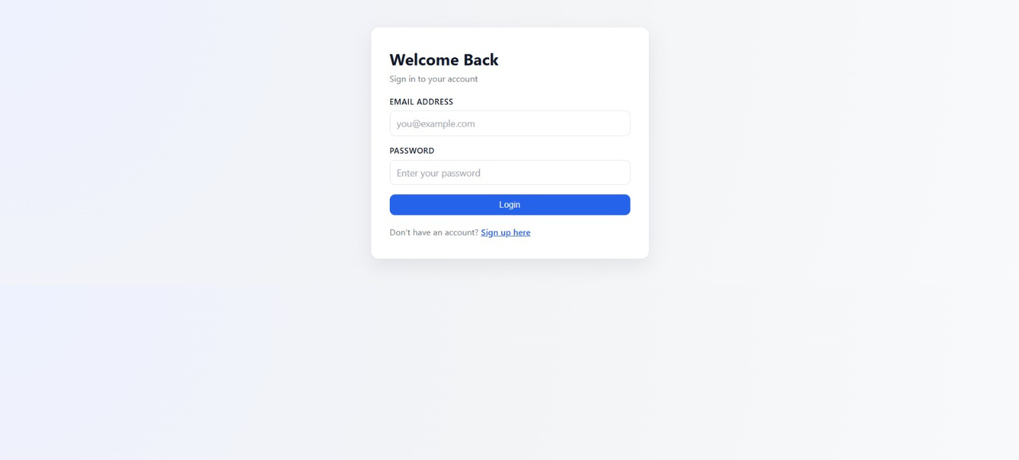
LOGIN

Slide 9
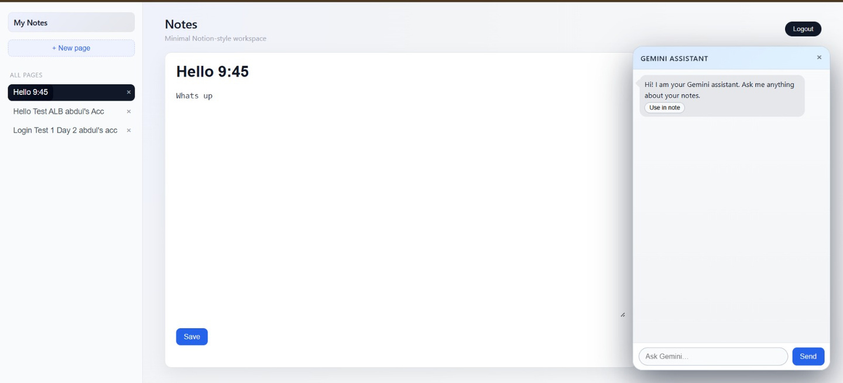
HOME PAGE UI
AI Chatbot
SideBar
Note Page

Slide 10
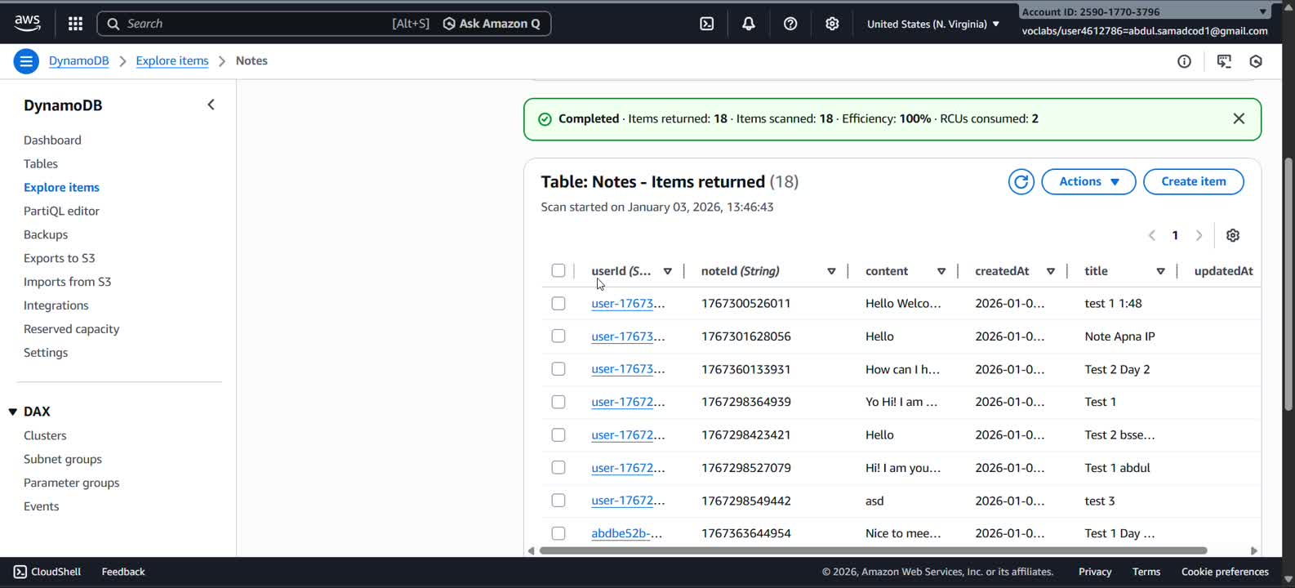
SIGNUP-CRUD-AI CHAT BOT TEST

Slide 11
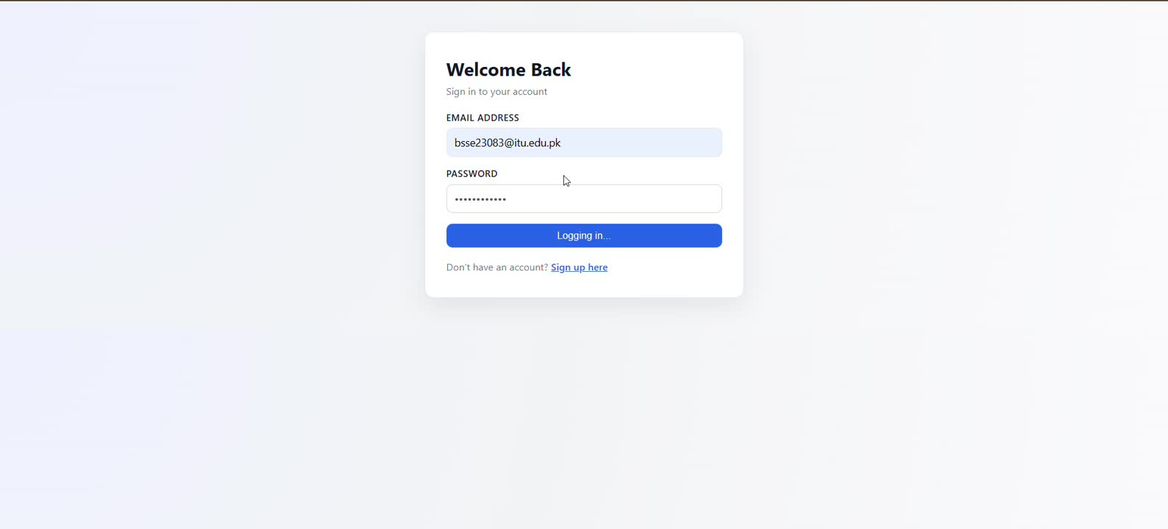
MULTPLE ACCOUNTS LOGIN TEST

Slide 12
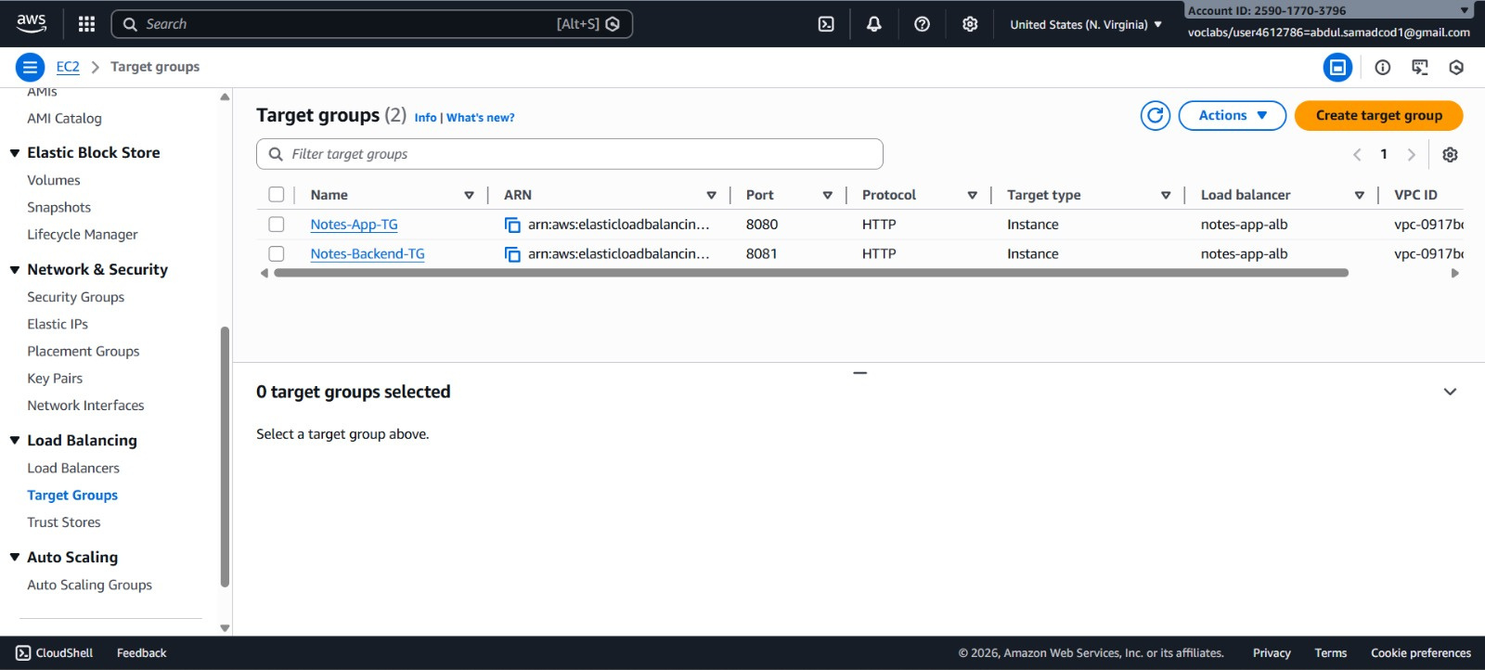
TARGET GROUPS

Slide 13
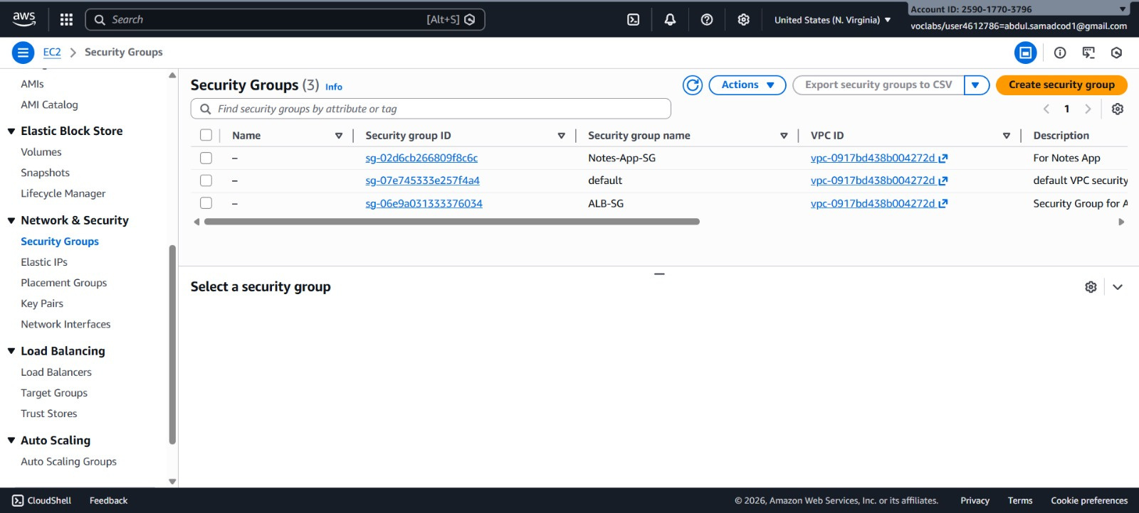
SECURITY GROUPS

Slide 14
EC2 INSTANCES ON DIFFERENT AZ

Slide 15
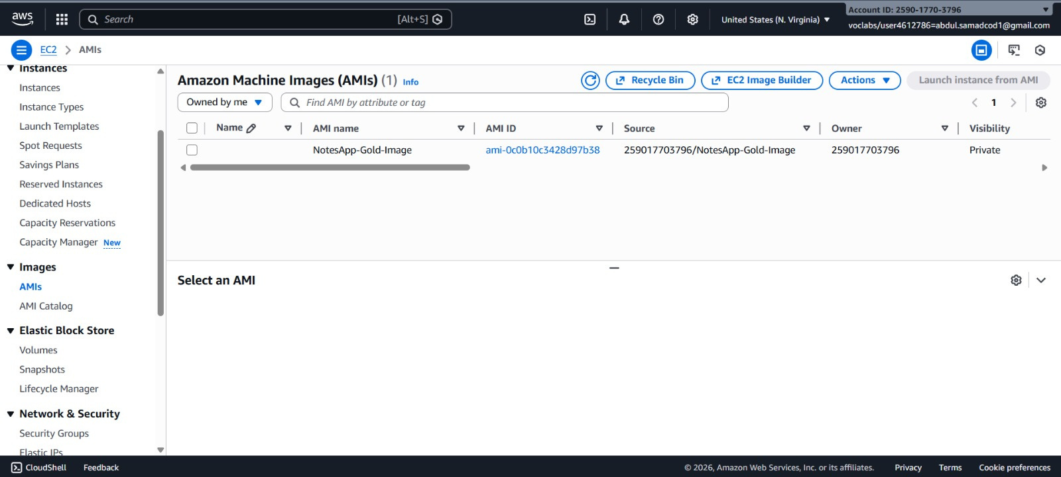
AMI

Slide 16
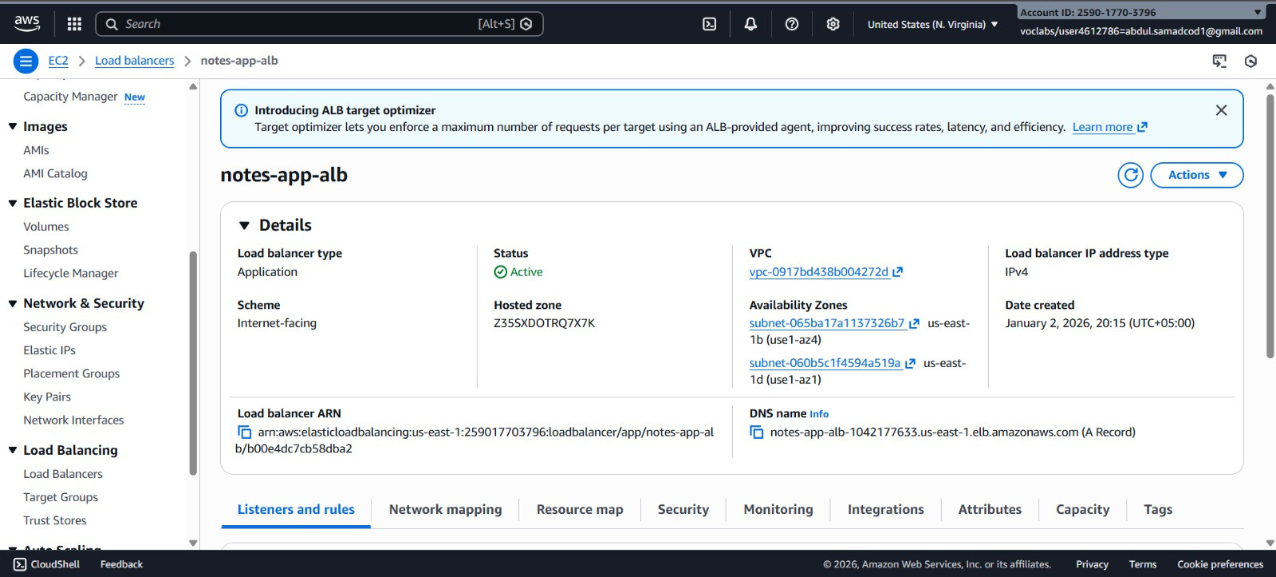
ALB (APPLICATION LOAD BALANCER)

Slide 17
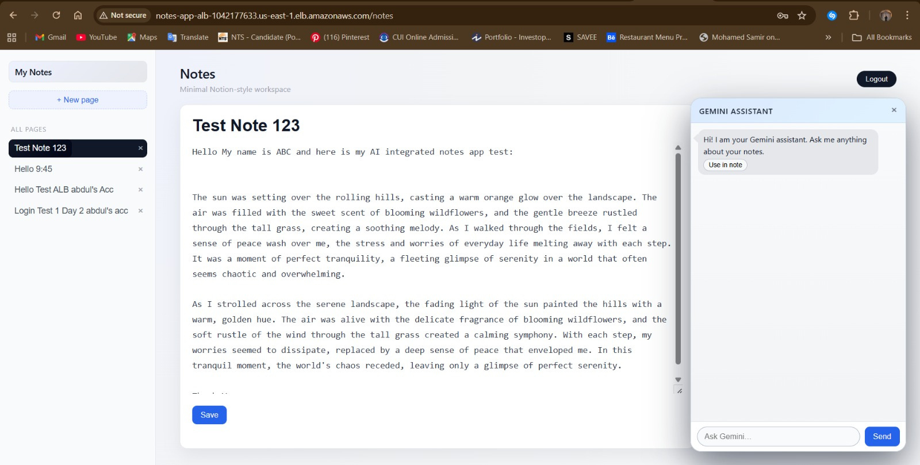
APPLICATION RUNNING ON ALB DNS
ALB DNS Link

Slide 18
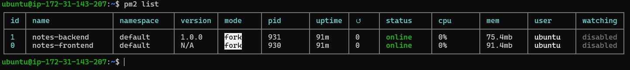
PM2 TESTING
Both the notes-frontend and notes-backend are Online. This confirms the Application Load Balancer (ALB) has "Healthy" targets to route traffic to.
The restart counter (↺) shows 0. This proves the backend is stable and has not crashed since the final code fixes were implemented.
With over 91 minutes of continuous uptime, the environment has moved past the initial debugging phase into a steady production state.

Slide 19
THANK YOU
for your time and attention

